Slide 1
Modular Arithmetic
How is addition different when you are doing it for time?

Slide 2
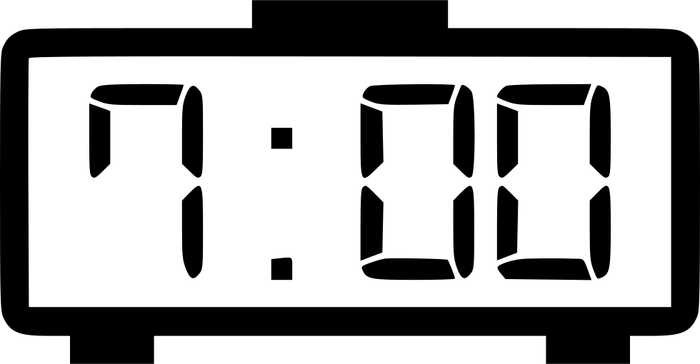
Snooze
My alarm clock goes off at 7:00 in the morning. Every time I hit the snooze, it goes off 5 minutes later. When I finally get up, what are the possible minutes my clock could say?
X
? ?
What if my snooze added 6 minutes? Or 15? Or 7?

Slide 3
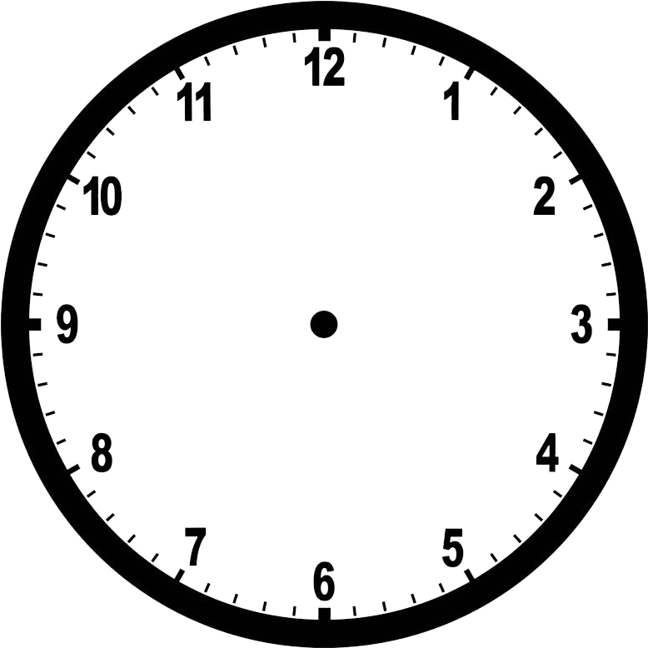
School Bell
The first bell goes off at 8:00. If the bell goes off every 50 minutes, will the bell ever go off when the minute hand is on 11? What about when the minute hand is on 2? 3?
?

Slide 4


Water Jugs
If I have a water jug that can hold 5 gallons, and another jug that can hold 3 gallons, can I find a way to have exactly 4 gallons? (No guesstimating! We need exactly 4 gallons!)

Slide 5
Water Jugs - Solution
Fill the 5 gallon jug.
Pour the water into the 3 gallon jug, leaving 2 gallons in the 5 gallon jug.
Pour the 3 gallon jug out.
Pour the 2 gallons left in the 5 gallon jug into the 3 gallon jug.
Fill the 5 gallon jug.
Fill the rest of the 3 gallon jug, using 1 gallon from the 5 gallon jug.
There is 4 gallons left in the 5 gallon jug!

Slide 6
Modular Arithmetic
What does clock addition look like? 12 is like 0, since 1+12=1 on the clock. How do we say this properly in math?
Big definition: Given 3 numbers, a,b,n, we say a and b are equivalent modulo n if a and b have the same remainder after dividing by n.
Another way to say this is a is equivalent to b modulo n. We write it like
a ≡ b mod n

Slide 7
Modular Arithmetic
Clock arithmetic is just looking at number modulo 12. We see that 12+1 = 13 ≡ 1 mod 12. Every number is equivalent to a number that is less than n modulo n.
Similarly:
11 ≡ 4 mod 7 | 13 ≡ 1 mod 2 | 12 ≡ 0 mod 3
13 ≡ 6 mod 7 | 9 ≡ -1 mod 10 | 11 ≡ 5 mod 3
7 ≡ 0 mod 7 | 103 ≡ 3 mod 20 | 11 ≡ 2 mod 3
x + 7 ≡ x mod 7 | 103 ≡ 19 mod 21 | 5 ≡ 8 mod 3

Slide 8
Break Out Rooms!

Slide 9
Modular Arithmetic Practice
Think about and solve these problems:
3 + 8 ≡ ? mod 2 | 2 × 3 ≡ ? mod 7
3 + 8 ≡ ? mod 4 | 2 × 3 × 4 ≡ ? mod 7
19 ≡ ? mod 8 | 2 × 3 × 4 × 5 ≡ ? mod 7

Slide 10
Back to Water Jugs
If I have a water jug that can hold 5 gallons, and another jug that can hold 3 gallons, can I find a way to have exactly 2 gallons? (No guesstimating! We need exactly 2 gallons!)

Slide 11
Different Water Jugs
If I have a water jug that can hold 6 gallons, and another jug that can hold 3 gallons, can I find a way to have exactly 2 gallons? (No guesstimating! We need exactly 2 gallons!)

Slide 12
Contrast with Modular Arithmetic
What numbers do you get by repeatedly adding (5 - 3) to itself modulo 5? Is there a way you can rephrase this repeated addition?
(5-3) + ⋯ + (5-3) ≡ ? mod 5
What numbers do you get by repeatedly adding (6 - 3) to itself modulo 6? Do you see a pattern forming?

Slide 13
Apply Ideas to Water Jugs
If I have a water jug that can hold 5 gallons, and another jug that can hold 3 gallons, can I find a way to have exactly 1 gallon?
If I have jugs with sizes 4 gallons and 7 gallons, can I make exactly 1 gallon? What other amounts can I make?
What about if the jugs hold 4 gallons and 10 gallons?
Challenge: When do we think we could make any amount of water if our jugs can hold x and y gallons of water?

Slide 14
Beyond the Water Jugs
Pouring water in is like adding, and pouring water out is like subtracking! What about when we cannot subtract?

Slide 15
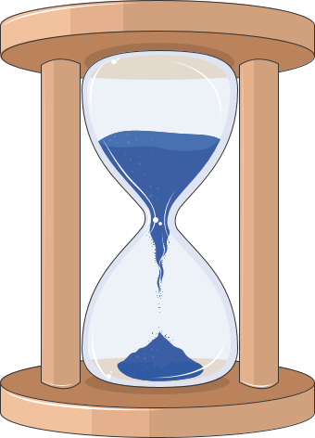
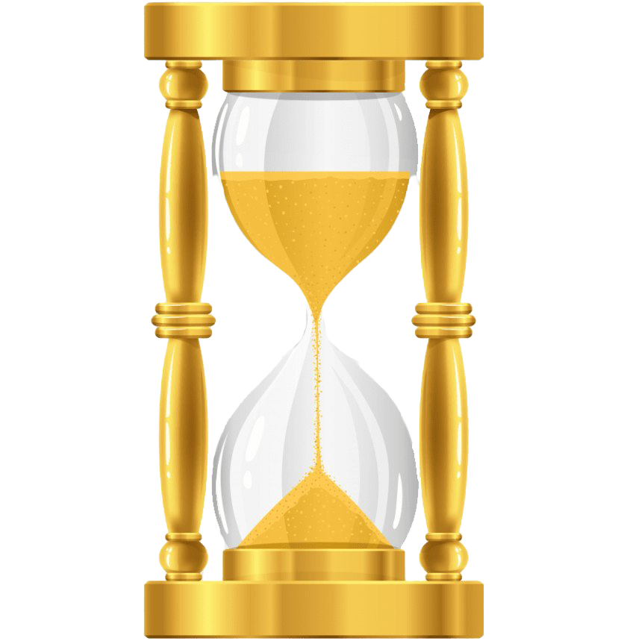
Hourglasses
I have two hourglasses, one that lasts for 9 minutes and another that lasts for 5 minutes. I need to cook my dinner for 13 minutes. Can I do it without guessing? Can I make a timer for any number of minutes?

Slide 16
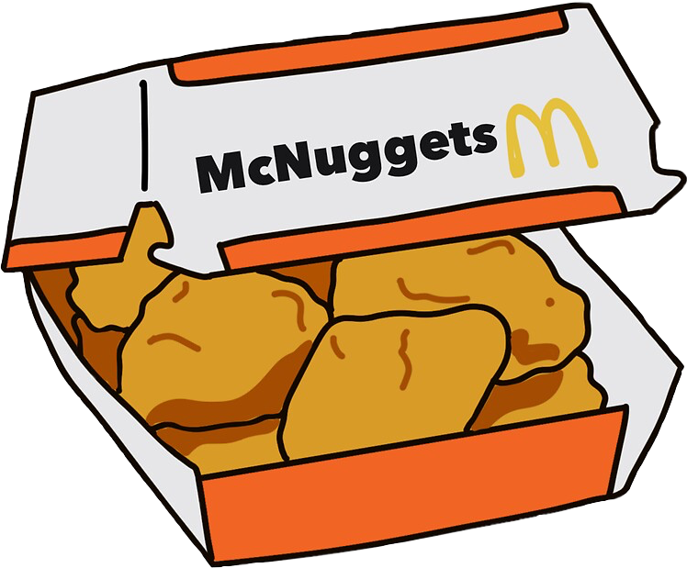
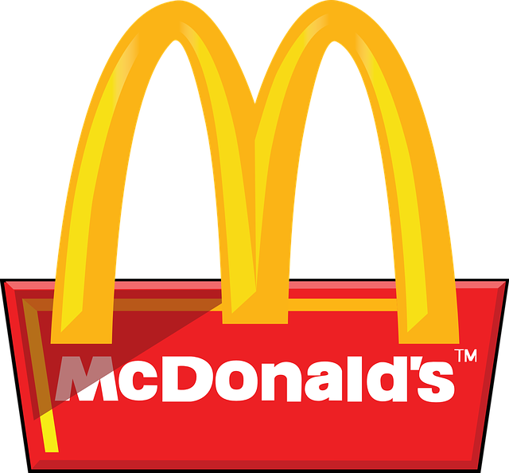
Chicken Nuggets
The McDonalds next to my house is very strange. They only sell chicken nuggets in packages of 3 and 5. This means some amounts of chicken nuggets I can never get exactly! Like 2 or 4. What is the largest number of chicken nuggets I cannot get exactly?

Slide 17
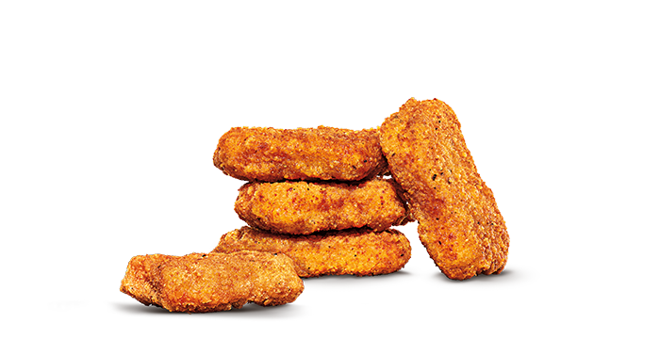
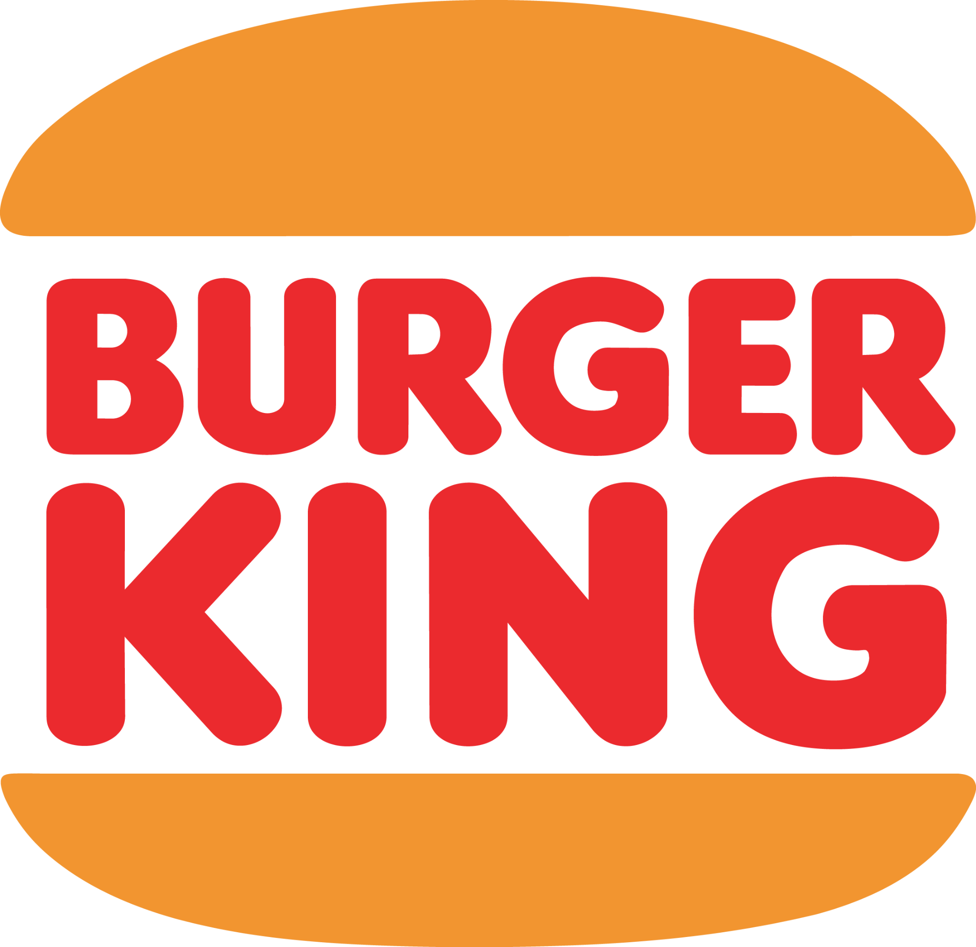
Chicken Nuggets - Burger King
My friend’s favorite Burger King does something similar. They only sell chicken nuggets in boxes of 3 and 7. What is the largest number of chicken nuggets you cannot exactly buy at Burger King?

Slide 18
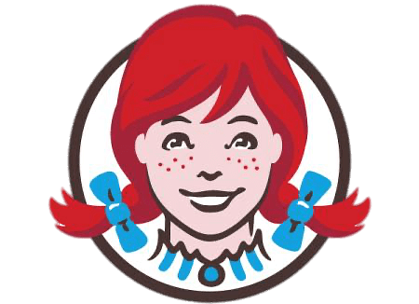
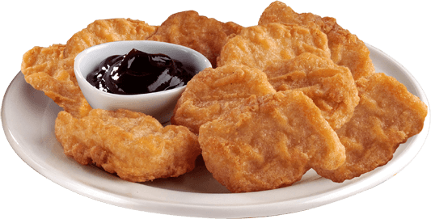
Challenge - Wendy’s
The nearby Wendy’s tries to compete by selling chicken nuggets in packages of 4, 7, and 9. What is the largest number of nuggets you cannot exactly order from Wendy’s?

Slide 19
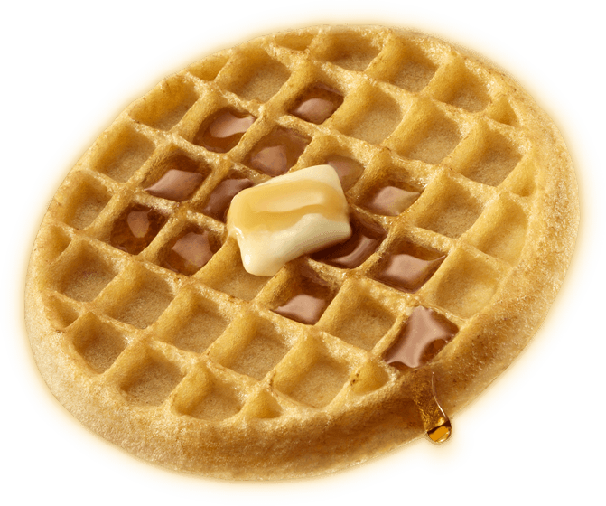
Waffle House
The Waffle House sells waffles in stacks of 5 and 10. What is the largest number of waffles we cannot order? How is this problem different from the rest of the problems?
Last Slide of Breakout Rooms!

Slide 20
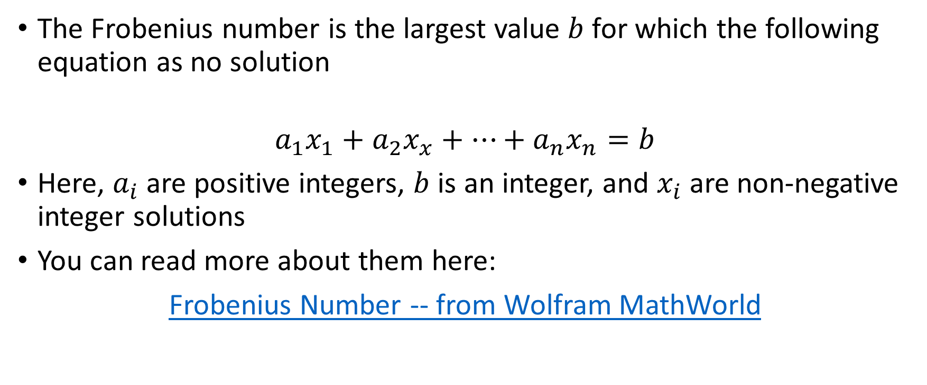
Frobenius Numbers!
Notes:
Frobenius Number -- from Wolfram MathWorld

